Slide 1

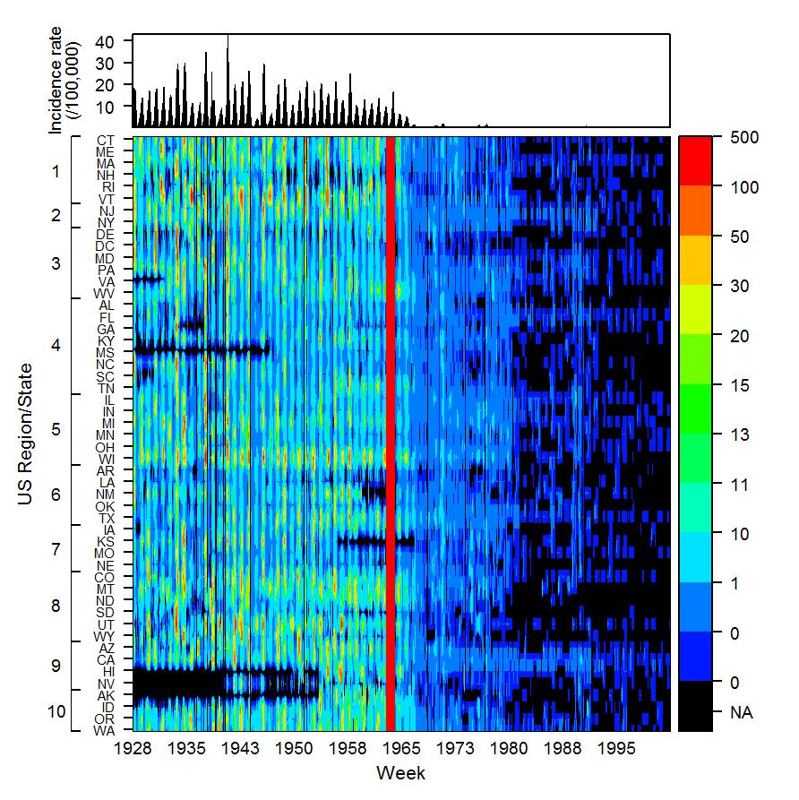
Measles
Incidence rates (/100,000)
Van Panhuis WG, et.al., NEJM 2013 Nov 28
Notes:
Measles weekly incidence rates for all states combined (Top panel) and for each state separately ordered by US Epidemiological region (Color diagram). Black indicates the absence of data. The vertical red line indicates the year of licensure (1963) of the Edmondston live attenuated measles vaccine.

