Slide 1
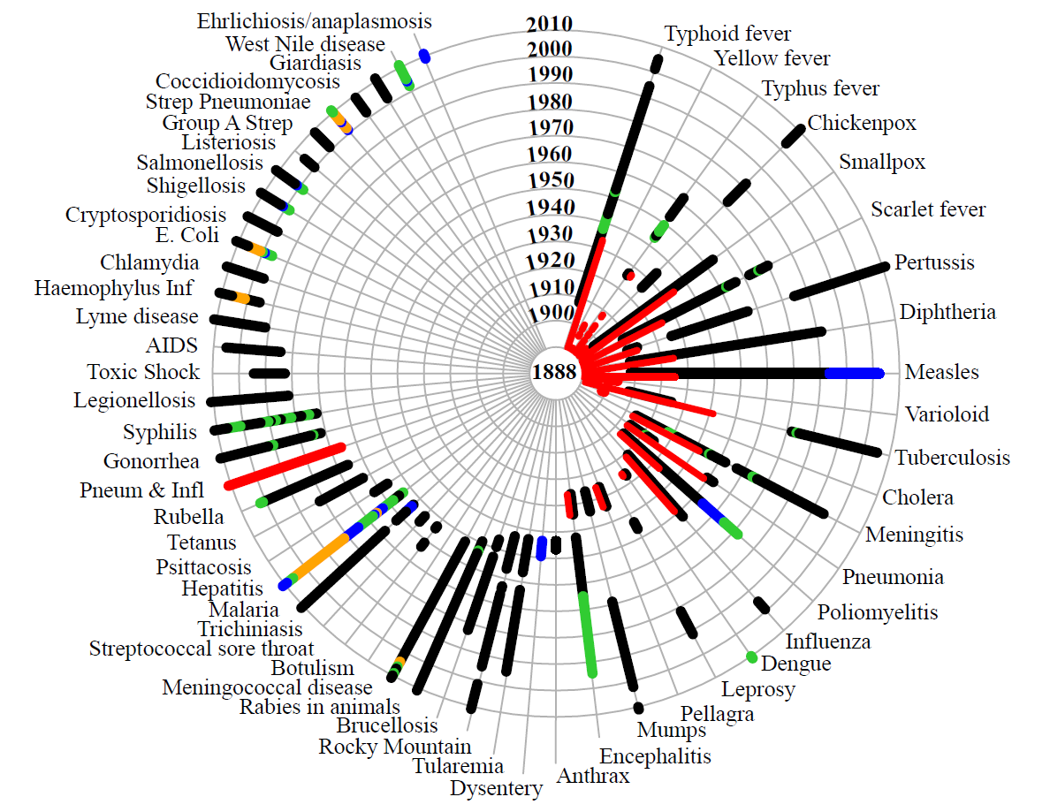
Death reports
Case reports for 1 subcategory
Case reports for 2 subcategories
Case reports for 3 subcategories
Case reports for >3 subcategories
Van Panhuis WG, et.al., NEJM 2013 Nov 28
Notes:
The history of weekly disease reporting in the United States since the start in 1888 until the present (2012). Each concentric circle represents a decade, starting with 1888 in the center. No single disease was reported at weekly intervals throughout the entire period, and for many diseases, the type of reports changed over time, as represented by different colors: red represents reports of deaths, and other colors represent reports of cases in different numbers of disease categories (e.g., hepatitis A and B) as follows: black, 1 category; green, 2; blue, 3; and orange, more than 3.

